Slide 1

DDP ASSIGNMENT 2 PRESENTATION
OH ERN QI S10243067K
1

Slide 2



TABLE OF CONTENT
01
02
03
04
PROBLEM STATEMENT
SOLUTION
OVERVIEW OF WORKFLOW
USER INPUT AND PREPARATION
05
06
07
08
API CALL FOR BUS TIMING API
DATA DISPLAY
USING OTHER APIS
WEBSITE AND POWERBI

Slide 3


PROBLEM STATEMENT
“Inefficient data use results in longer wait times and missed buses for commuters, and hinders bus operators from improving routes, schedules, and fleet management.”

Slide 4



SOLUTION
FOR COMMUTERS: A REAL-TIME BUS INFORMATION SYSTEM PROVIDING ACCURATE BUS ARRIVAL TIMES
FOR BUS COMPANIES: COLLECT DATA FOR DATA ANALYSIS PLATFORM TO HELP OPTIMIZE OPERATIONAL EFFICIENCY

Slide 5
OVERVIEW OF ALTERYX WORKFLOW
APIs used : Bus Timing API, Bus Route API ,Bus Stop API
Other Tools : HTML, CSS, PowerBI
Steps in Work Flow:
User Input and Preparation
API Call for Bus Timing API
Displaying Data
Creating New Features
Combining with other APIs (Bus Route and Bus Stop)
Displaying to Website
Dashboard in PowerBI

Slide 6
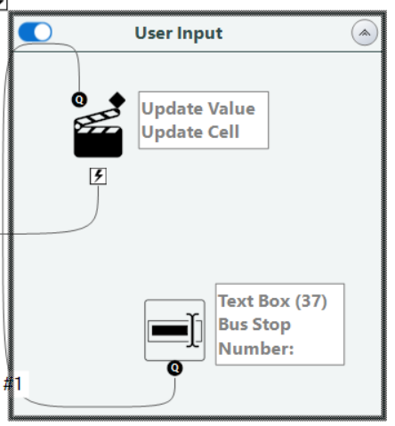
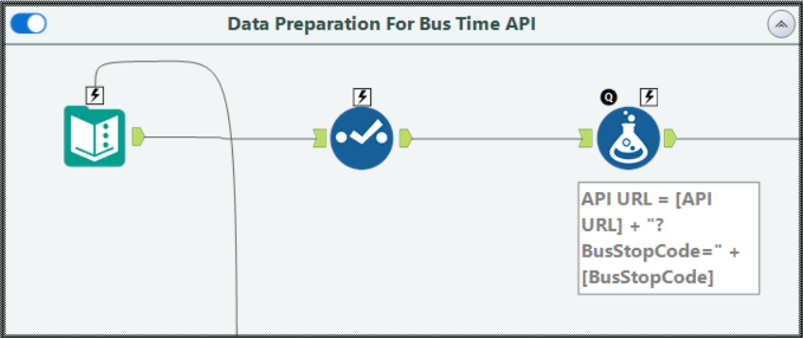

USER INPUT AND PREPARATION
Convert “BustStopCode” to String
User Input Capture:
Collect 'Bus Stop Number' via user interface.
Input feeds into 'BusStopCode' Column in Text Input
URL Construction:
Use Alteryx formula to concatenate 'BusStopCode' with the base API URL.
Create full API endpoint

Slide 7
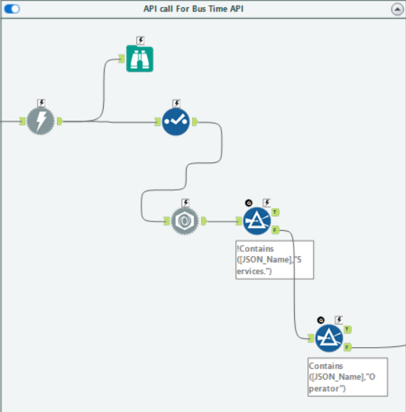
API CALL FOR BUS TIMING API
API Data Download:
Execute GET request to retrieve JSON data from transportation API.
JSON Parsing:
Use JSON Parse tool to organize API response into 'JSON Name' and 'JSON Value String' columns.
Data Filtering:
Exclude non-essential information, such as records without 'Services' and 'Operator' details.

Slide 8
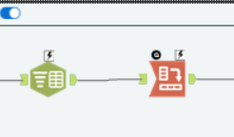
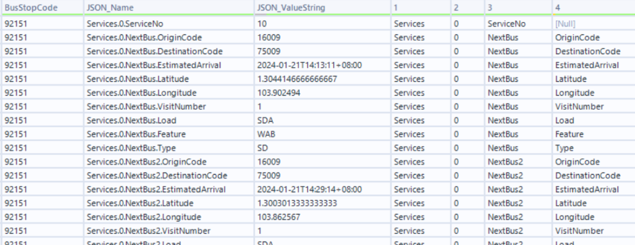
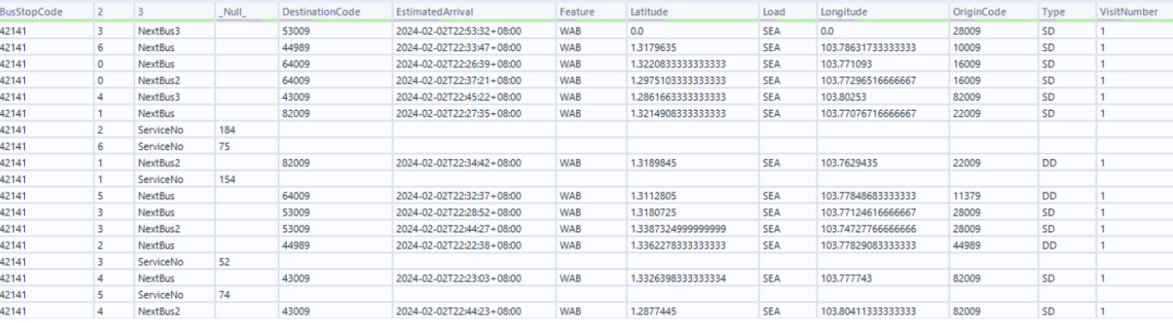
DISPLAYING DATA
Text to Column Transformation:
Convert JSON format to user-friendly table.
Delimit 'JSON_Name' into separate columns for readability.
Cross Tabulation:
Group data by bus stop and flatten JSON structure.
Configure column headers to match the new flat data format.

Slide 9
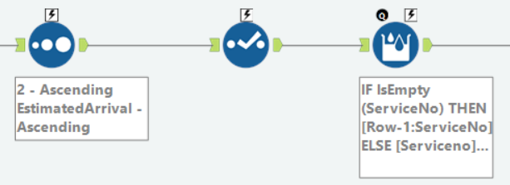
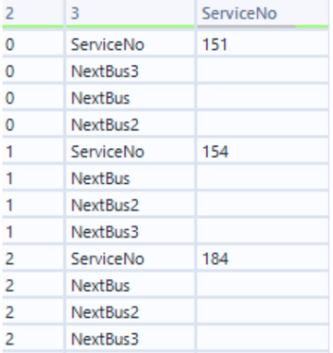
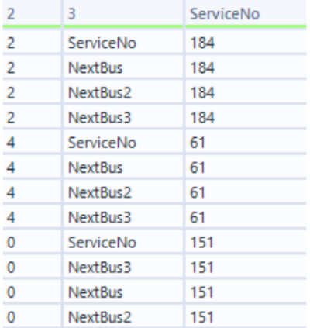
DISPLAYING DATA-CONT.
Sorting Data:
Sort by service number and estimated arrival times.
Group buses with the same service number together.
Impute Missing Service Numbers:
Ensure continuous and accurate service number data across records.

Slide 10
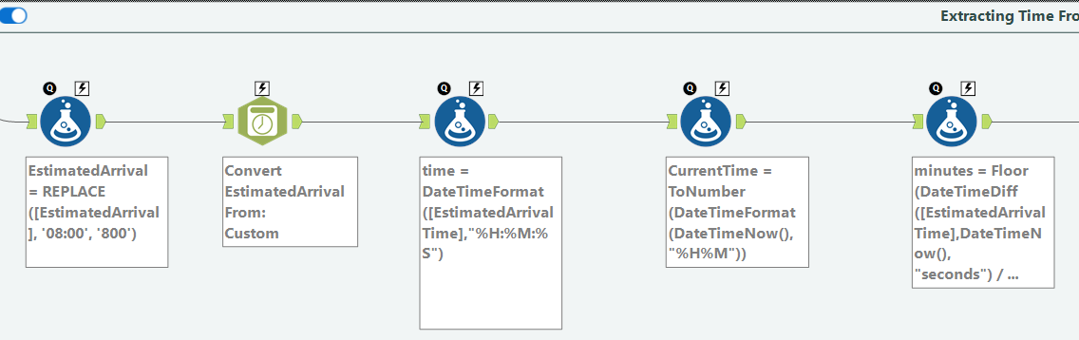
EXTRACTING INFORMATION FROM ESTIMATED ARRIVAL TIME
Timestamp Formatting:
Replace timezone information and convert to datetime.
Format time to be in Hours Minutes and Seconds only
Time Difference Calculation:
Calculate minutes until bus arrival using DateTimeDiff function
Subtract time of arrival by current time
Floor the results to nearest minutes

Slide 11
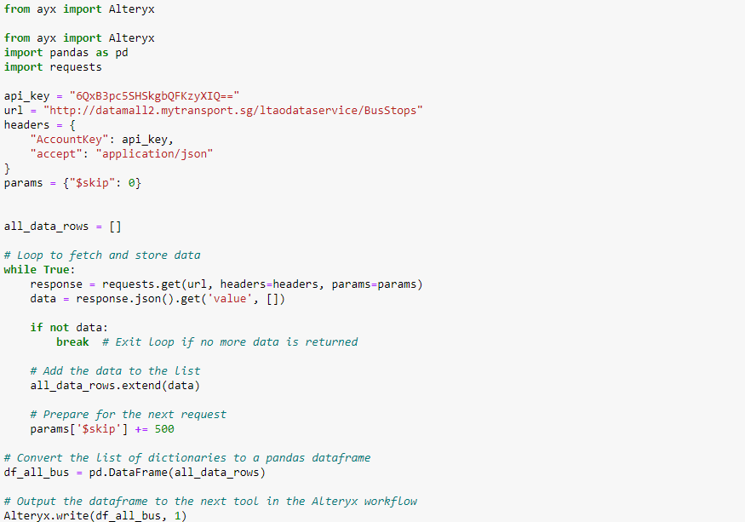
USING PYTHON TO EXRACT API DATA
Set Up API Request:
Initialize headers with API key and content type.
Data Retrieval Loop:
Continuously fetch data from API in batches.
Break loop when no additional data is received.
Data Storage:
Store retrieved data in a list.
Increment request parameter to retrieve next batch.
Dataframe Conversion:
Convert list of data to a pandas dataframe to be used in workflow

Slide 12
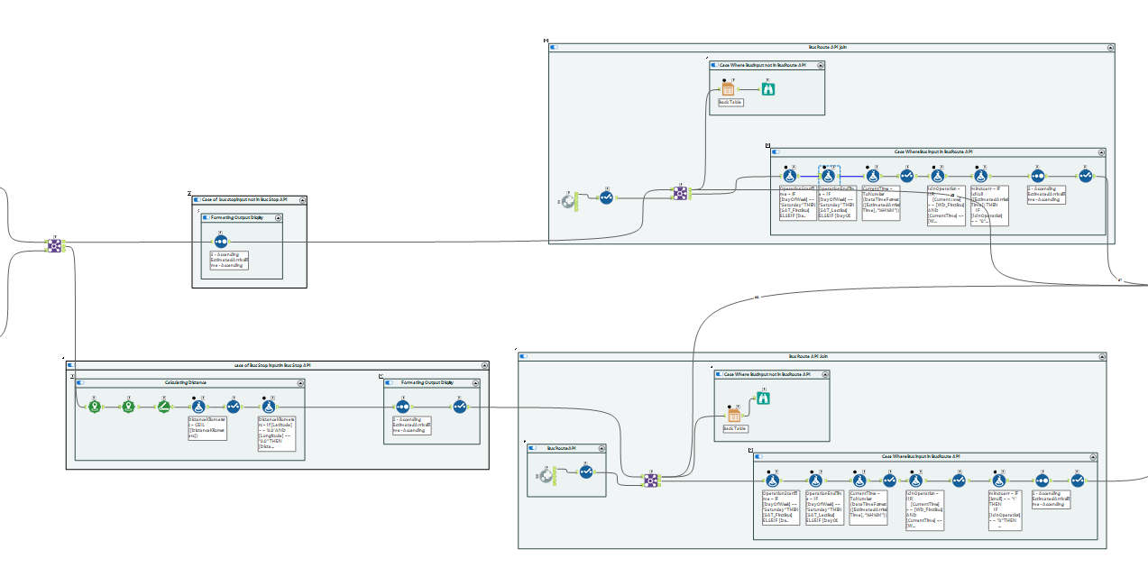
SUPPORTING APIS ERROR HANDLING
Bus stop input not in API
Join with bus route API on Bus stop Number and Service Number
Bus stop input in API
Join with bus stop API on Bus stop Number
Bus stop input not in API
Bus stop input in API
Bus stop input not in API
Bus stop input in API
Join with bus route API on Bus stop Number and Service Number

Slide 13



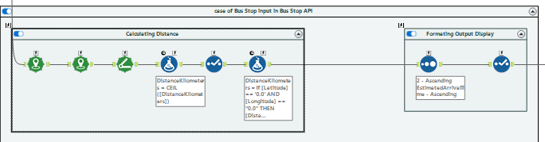
COMBINING WITH OTHER APIS (BUS STOP)
Data Joining:
Combine bus timing and bus stop API data based on matching bus stop codes.
Separate unmatched data to a different stream
Bus Stop Details Enhancement:
Add bus stop description and road name for easy identification.
Calculate distance between bus and bus stop using latitude and longitude.

Slide 14
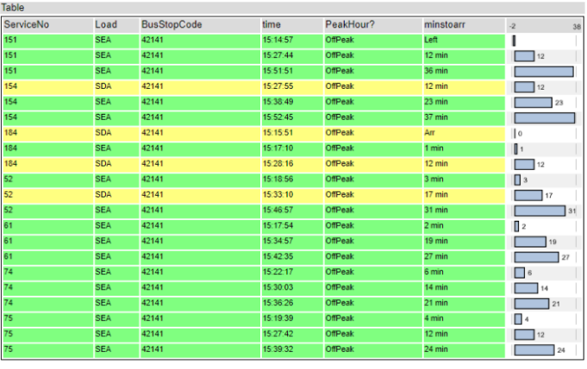
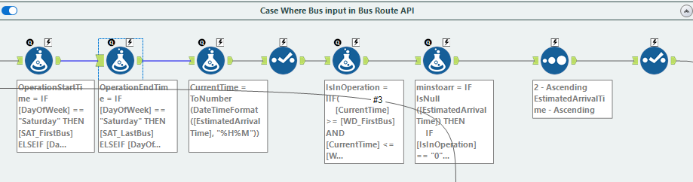
COMBINING WITH OTHER APIS (BUS ROUTE)
Operational Status Assessment:
Use formulas to determine buses' in-service status based on current time and scheduled operational hours.
Update Mintoarr code to include “not in operation” Status
Handling Unmatched Bus Stop Numbers:
Direct non-corresponding user inputs to a default information stream.

Slide 15
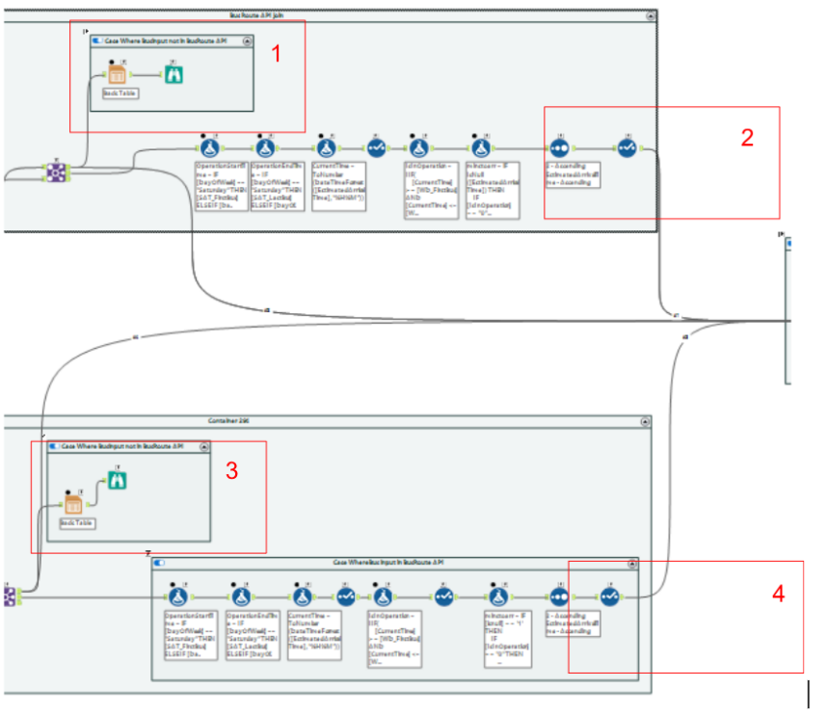
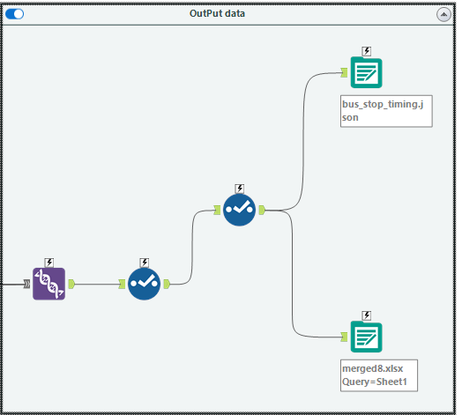

OUTPUT FROM WORKFLOW
Data from only the Bus Timing API.
Combined data from the Bus Timing and Bus Stop APIs.
website
code
Combined data from the Bus Timing and Bus Route APIs.
powerbi
An integration of data from the Bus Timing, Bus Route, and Bus Stop APIs

Slide 16
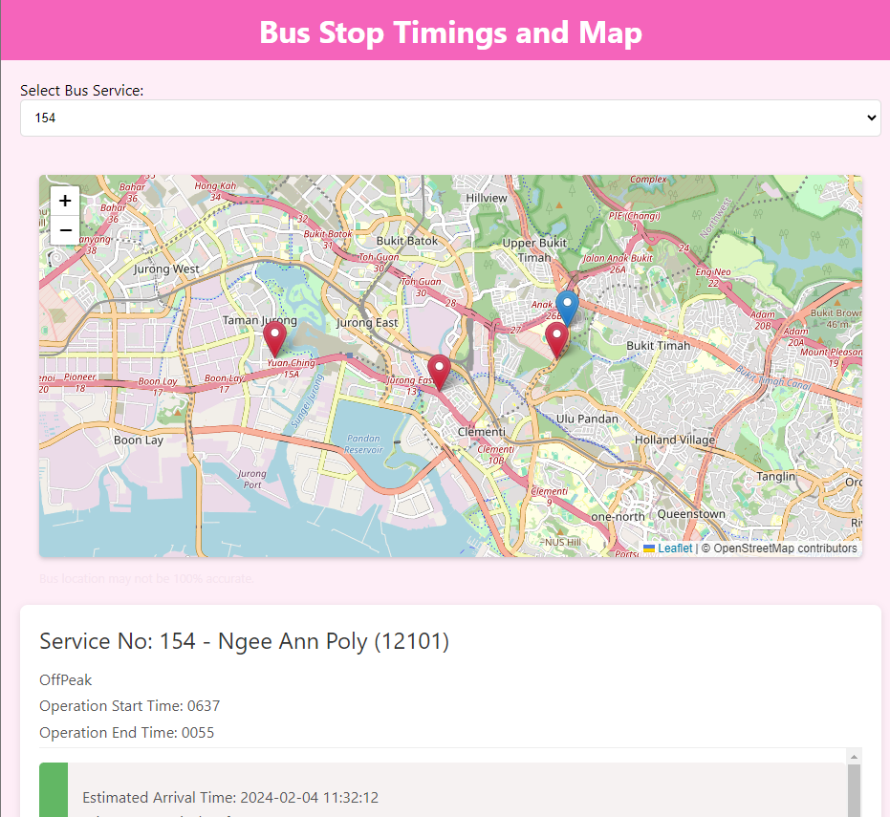

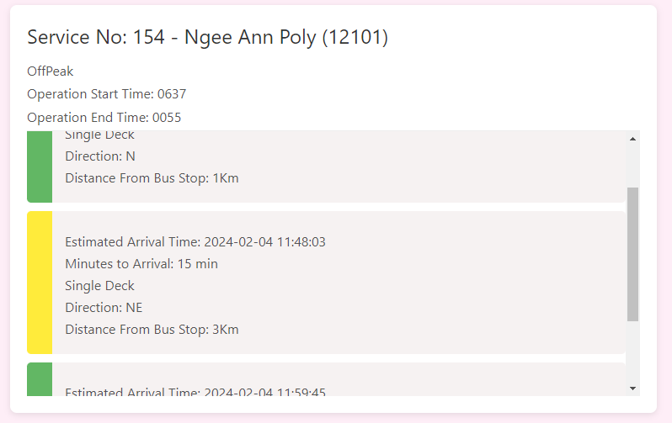
Website for Front End Users

Slide 17
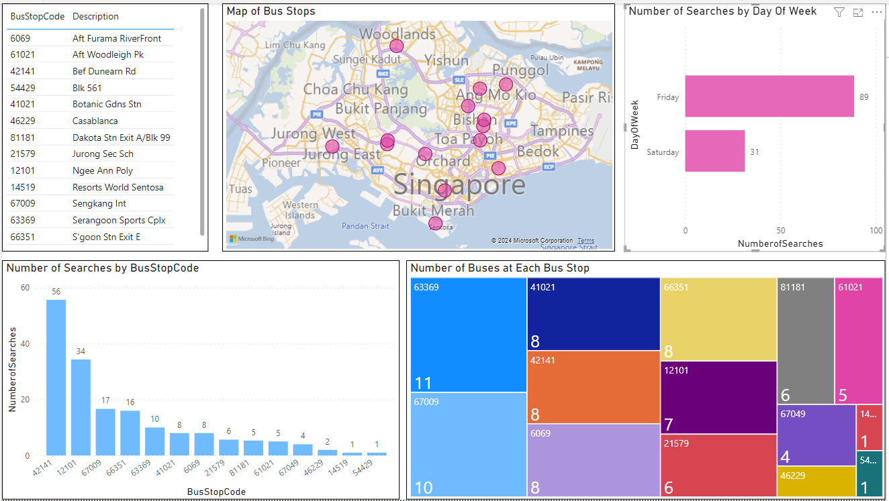
PowerBI Dashboard for Back End Data analysis - Bus Stop Analysis
Identify high-density bus stop areas
number of searches by bus stop code
search frequency by day of the week
Analyze passenger usage trends
Inform decisions on service frequency and stop improvements

Slide 18
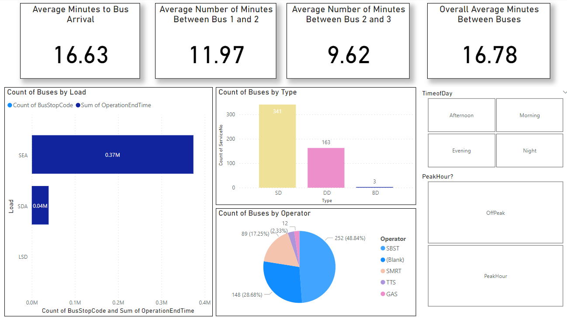
PowerBI Dashboard for Back End Data analysis - Bus Analysis
Display average waiting times and headway statistics.
Visualize passenger volume and identify crowded routes depending on time of day
Analyze the number of buses by type and operator
Use data to guide fleet management

Slide 19

Thank
you !

Slide 20


Demo Time!

